Slide 1
Chapter Six
Wide Area Network (WAN)

Slide 2
A Taxonomy of Communication Networks
Communication networks can be classified based on the way in which the nodes exchange information.

Slide 3
Introduction to WAN
utilize protocols at levels 1-3 of the OSI reference model that are optimized, both physically and logically, for extended travel
when you select a WAN technology, you will be faced with many confusing options:
the amount of data they can deliver,
the speed at which they operate,
their initial and recurring costs,
their management requirements, and
their flexibility to include new locations or new technologies such as voice or video

Slide 4
Switching
involves moving something through a series of intermediate steps, or segments, rather than moving it directly from start point to end point
serves the same purpose as the direct connection, but it uses transmission resources more efficiently
WAN uses switching
There are different kinds of switching:
Circuit switching
Packet switching
Message switching
WANs rely primarily on packet switching, but they also make use of circuit switching, message switching,
the relatively recent, high-speed packet-switching technology known as cell relay

Slide 5
Circuit Switching
involves creating a direct physical connection between sender and receiver
a connection lasts as long as the two parties need to communicate
allows for a fixed (and rapid) rate of transmission
switching is done at the physical layer
The primary drawback is
any unused bandwidth remains exactly unused
The most common form of circuit switching - the telephone system
but circuit switching is also used in some networks

Slide 6
Advantages:
fixed delays
guaranteed continuous delivery
Disadvantages
the long connection delay (between the end of dialing and the start of ringing)
circuits are not used when session is idle
inefficient for bursty traffic
usually done using a fixed rate stream (e.g., 64 Kbps) - difficult to support variable data rates

Slide 7
2. Message Switching
does not involve a direct physical connection
When a network relies on message switching, the sender can fire off a transmission—after addressing it appropriately—whenever it wants
when the sender has a block of data to be sent,
it is stored in the first switching office (i.e., router) and then forwarded later;
each block is received in its entirety, inspected for errors, and then transmitted - a store-and-forward network

Slide 8
the intermediaries aren't required to forward messages immediately.
Instead, they can hold messages before sending them on to their next destination
no limit on block size; routers need disk buffers
a single block may tie up the line
not in use anymore

Slide 9
3. Packet Switching
similar to message switching,
but with a tighter limit on block size so that packets can be buffered in memory rather than on disk
suitable for interactive traffic; no monopoly
all transmissions are broken into units called packets,
each of which contains addressing information that identifies both the source and destination nodes
These packets are then routed through various intermediaries, known as Packet Switching Exchanges (PSEs)
packet-switched networks transfer data over variable routes
At each node the entire packet is received, stored, and then forwarded (Store-and-Forward Networks)

Slide 10
There has to be some kind of connection — either connectionless or connection-oriented services, depending on the type of packet-switching network involved
In establishing the link between sender and recipient, a connection-oriented service can make use of
either Switched Virtual Circuits (SVCs)
or Permanent Virtual Circuits (PVCs)
Using a switched virtual circuit is comparable to calling someone on the telephone
Using a permanent virtual circuit, on the other hand, is more like relying on a leased line

Slide 11
A packet-switching network might be, for example,
a frame relay network
an ATM (Asynchronous Transfer Mode) network
Etc.
Advantage
Line efficiency
Single node to node link can be shared by many packets over time
Packets queued and transmitted as fast as possible
Data rate conversion
Each station connects to the local node at its own speed
Nodes buffer data if required to equalize rates
Packets are accepted even when network is busy
Delivery may slow down
Priorities can be used

Slide 12
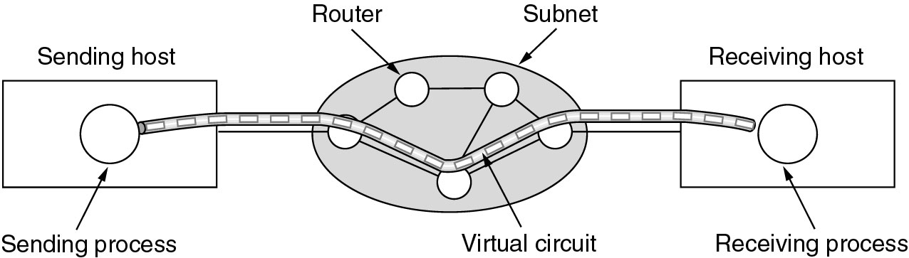
two popular approaches to packet switching: the Datagram Approach and the Virtual Circuit approach
Virtual Circuit approach - a data link layer technology
Hybrid of circuit switching and packet switching
a single route is established between sender and receiver at the beginning of the session by sending a set-up packet
as the packet travels all the way, the routers on the path record an entry in their internal tables and make reservation of resources at the beginning
a call teardown deletes
no routing decision is made by every switch for every packet; it is made only once and the virtual circuit
used for connection-oriented services
e.g., ATM (Asynchronous Transfer Mode)

Slide 13
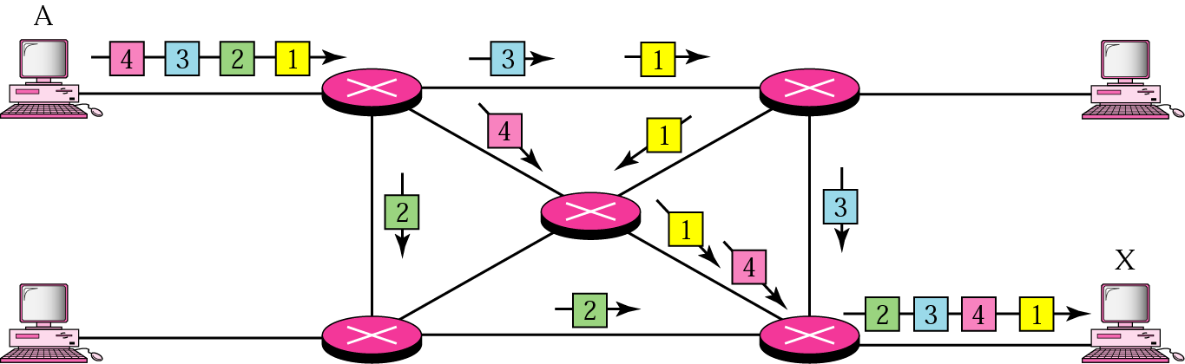
Datagram Approach - mostly used in the network layer
each packet is treated independently of all others
packet in this approach is referred to as datagram
used for connectionless services
route chosen on packet-by-packet basis
different packets may follow different routes
packets may arrive out of order at the destination
Up to receiver to re-order packets and recover from missing packets
e.g., IP - The Internet Protocol

Slide 14
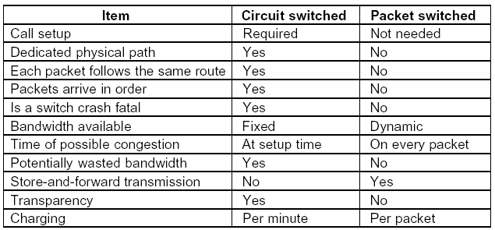

Slide 15
Frame Relay
Often referred to as a fast packet switching technology
transfers variable-length packets
up to 4 KB in size at 56 Kbps or T1 (1.544 or 2 Mbps) speeds over permanent virtual circuits
Operating only at the data link layer
was designed to take advantage of newer digital transmission capabilities, such as fiber optic cable and ISDN
These offer reliability and lowered error rates
include a means of detecting corrupted transmissions through a cyclic redundancy check, or CRC
does not include any facilities for error correction
the sender does not overwhelm the recipient with too much data

Slide 16
because it operates over permanent virtual circuits (PVCs)
transmissions follow a known path
and there is no need for the transmitting devices to figure out which route is best to use at a particular time
It provides end-to-end service over a known — and fast —digital communications route
It is based on multiplexing a number of (virtual) circuits on a single communications line

Slide 17
response to congestion
First, to request the sending application to slow down a little its transmission speed
Second, involves discarding frames flagged as lower-priority deliveries
Frame relay networks connecting LANs to a WAN rely on routers and switching equipment capable of providing appropriate frame-relay interfaces

Slide 18
ATM (Asynchronous Transfer Mode)
is a transport method
capable of delivering not only data but also voice and video simultaneously and over the same communications lines
is a connection-oriented networking technology
closely tied to the ITU's recommendation on broadband ISDN (BISDN)
is good for high-speed LAN and WAN networking over a range of media types
from the traditional coaxial cable, twisted pair, and fiber optic to communications services of the future, including FDDI, and SONET

Slide 19

like frame relay, it is based on packet switching
however, it relies on cell relay, a high-speed transmission method
based on fixed-size units (tiny ones only 53 bytes long) that are known as cells and that are multiplexed onto the carrier.
It is so fast as uniformly sized cells travel faster and can be routed faster
Transmission speeds are commonly 56 Kbps to 1.544 Mbps,
but the ITU has also defined ATM speeds as high as 622 Mbps (over fiber optic cable)
ATM cell

Slide 20
It is a wonderful means of transmitting all kinds of information at high speed.
It is reliable, flexible, scalable, and fast because it relies on higher-level protocols for error checking and correction
It can interface with both narrowband and broadband networks,
It is especially suitable for use in a network backbone

Slide 21
Downside
ATM networks must be made up of ATM-compatible devices
they are both expensive and not yet widely available
there is a chicken-or-egg dilemma facing serious ATM deployment:
businesses are not likely to incur the expense of investing in ATM-capable equipment if ATM services are not readily available through communications carriers over a wide area, yet carriers are reluctant to invest in ATM networking solutions if there is not enough demand for the service

Slide 22
BISDN
is next-generation ISDN,
Is a technology that can deliver all kinds of information over the network
information is divided into two basic categories, interactive services and distributed (or distribution) services.
Interactive services include you-and-me types of transactions, such as videoconferencing, messaging, and information retrieval
Distributed services include you-to-me types of information that are either delivered or broadcast to the recipient
These services are further divided into
those that the recipient controls (for example, e-mail, video telephony, and telex) and
those that the recipient cannot control other than by refusing to "tune in" (for example, audio and television broadcasts)

Slide 23
The difference between narrowband ISDN and BSDN is the method of delivery
Narrowband ISDN transmissions are based on time division multiplexing (TDM),
which uses timing as the key to interleaving multiple transmissions onto a single signal
BISDN uses ATM, with its packet switching and its little 53-byte cells
BISDN is comparable to a catalog shopping service that delivers everything from food to clothing, and ATM is like the boxes in which those products are packaged and delivered

Slide 24
Routing and Routing Protocols
making a decision and choosing one route whenever there are multiple routes based on some criteria
it is the job of the network layer routing protocol
at the heart of such protocol is the routing algorithm that determines the path for a packet
The routing algorithm is responsible for deciding which output line an incoming packet should be transmitted on.
Routing involves two basic activities:
determining optimal routing paths and
transporting information groups (typically called packets) through an internetwork.

Slide 25
If the subnet uses datagram internally this decision must be made anew for every arriving packet.
On the other hand if the subnet uses Virtual Circuits (VCs), this decision is made only when a new virtual circuit is set up.
Desirable properties of a routing algorithm:
correctness,
simplicity,
robustness,
stability,
fairness, and
Optimality

Slide 26
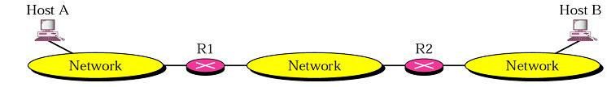

routing requires a host or a router to have a routing table which is constructed by the routing algorithm
given big internetworks such as the Internet, the number of entries in the routing table becomes large and table look ups become inefficient;

Slide 27

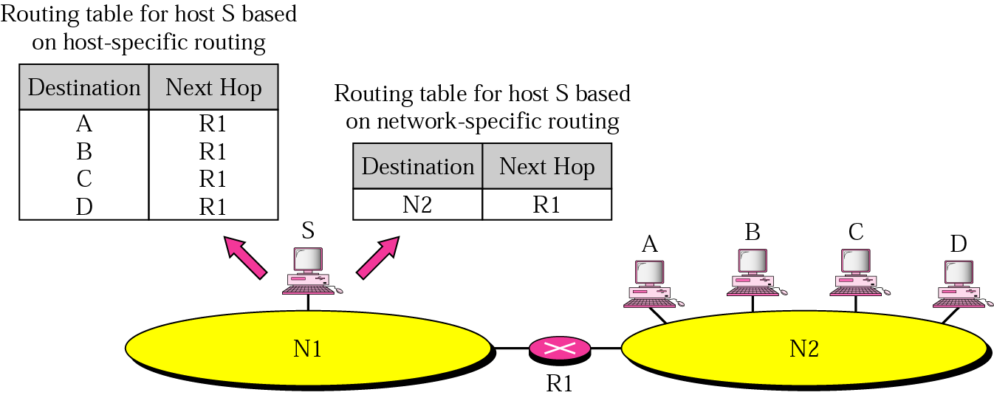
methods for reducing its size required
Next-Hop Routing
the routing table holds only the information that leads to the next hop
Network Specific Routing
instead of having an entry for every host connected to the same physical network, there is only one entry to define the address of the network itself

Slide 28
Routing Vs Forwarding
Forwarding deals with getting a packet in one line and putting it in an outgoing line.
As a function it is the force that gets packets moving in a network.
Routing deals with choosing the correct outgoing line to place a packet for transmission.
routing algorithms must converge rapidly.
Convergence is the process of agreement, by all routers, on optimal routes
Routing algorithms that converge slowly can cause routing loops or network outages

Slide 29
Types of Routing Algorithms (routing tables):
non-adaptive (static)
adaptive (dynamic)
Nonadaptive (Static)
routing decisions are not based on measurements or estimates of the current topology or traffic
the choice of a root is computed in advance, off-line, and downloaded to the routers when the network is booted or
an administrator enters the route for each destination into the table;
not automatically updated when there is a change;
may be used in a small internet, but not for big internet like the Internet

Slide 30
Adaptive (Dynamic)
routing decisions are made periodically (every δ sec) to reflect
changes in the topology,
changes in traffic,
a shutdown of a router,
a break in the link,
a better route has been created, ...

Slide 31
Routing Protocols
use metrics to evaluate what path will be the best for a packet to travel
a metric is a cost assigned for passing through a network
the cost could be
the level of congestion of a link (mean queue length, transmission delay, average traffic),
bandwidth,
the geographic distance traversed by the link,
number of hops,
estimated transit time,
communication cost, ...

Slide 32
cost may change with time
which cost to choose depends on the application
the total metric of a particular route is equal to the sum of the metrics of networks that comprise the route
a router chooses the route with the shortest (smallest) metric
Interior and Exterior Routing (protocols)
since an internet can be large, one routing protocol cannot handle the task of updating the routing tables of all routers
hence, an internet is divided into Autonomous Systems
an Autonomous System (AS) is a group of networks and routers under the authority of a single administration
routing inside an autonomous system is referred to as Interior Routing;

Slide 33
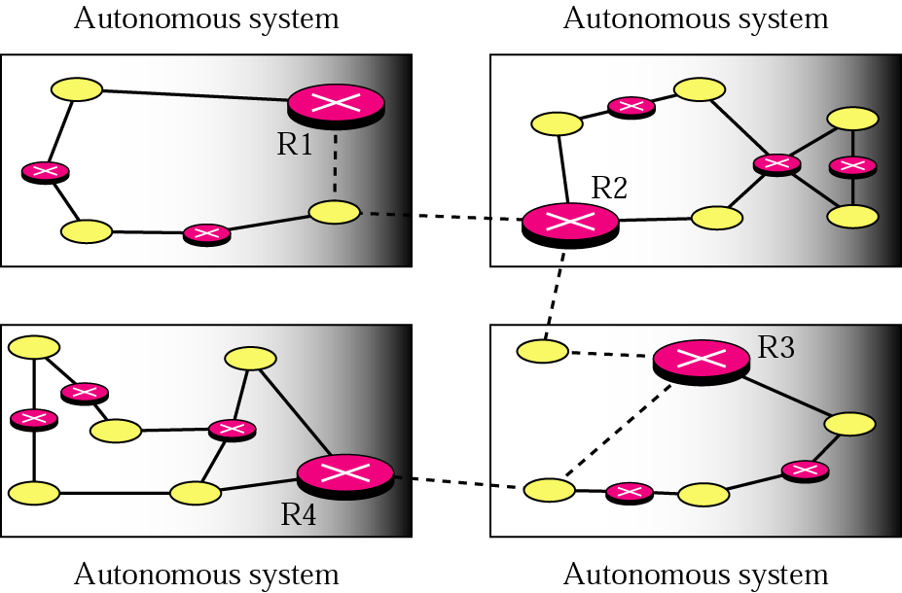
each AS can choose its own routing protocol
routing between autonomous systems is referred to as Exterior Routing;
one protocol is usually chosen to handle routing between autonomous systems;
usually used for routing in the Internet

Slide 34
R1, R2, R3, and R4 use both interior and exterior routing protocols
the rest use only interior routing protocols
solid lines - communication between routers
broken lines - communication between the routers that use an exterior routing protocol
why an exterior routing protocol apart from size of an internet? - politics
political - I hate country X hence I will not handle its traffic
security - my information is confidential and should not pass through a hostile country

Slide 35
economic
it should not pass through a competitor’s network
I am not paid for it and hence don’t want to carry a transit packet
such policies are typically manually configured into each router and are not part of the protocol itself

Slide 36
The Optimality Principle: the optimal route
if router J is on the optimal path from I to K, then the optimal path from J to K also falls along the same route
why?
if a route better than R2 existed from J to K, then the route from I to K could be improved by concatenating it with R1
the consequence of the optimality principle is that
“the set of optimal routes from all sources to a given destination form a tree rooted at the destination”
such a tree is called a Sink Tree

Slide 37
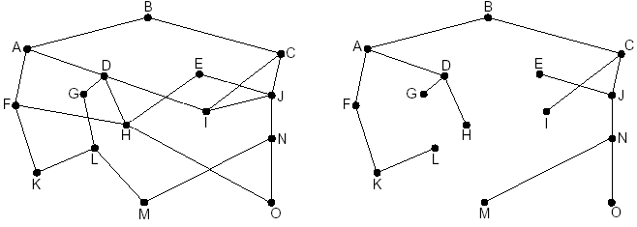
a subnet sink tree for router B
(distance metric is the number of hops)
the sink tree is not necessarily unique;
as a tree it does not contain any loops;
each packet will be delivered within a finite and bounded number of hops; at least in theory

Slide 38
the goal of a routing algorithm is to discover the sink trees for all routers
the optimality principle and the sink tree serve as benchmarks to measure routing algorithms
Shortest Path Routing (static) for unicast routing (by Dijkstra)
aim:
build a graph of the subnet - each node of the graph representing a router and each arc representing a link;
the arcs are labeled as a function of any one of the metrics discussed (distance, hop count, ...)
to select a route between two routers, the algorithm finds the “shortest” path between them on the graph

Slide 39
how does the algorithm work to find the shortest path?
each node is labeled with its distance from the source;
initially labeled ∞ since no path is known
a label may be tentative or permanent (when the shortest possible path is found - filled-in circle)

Slide 40
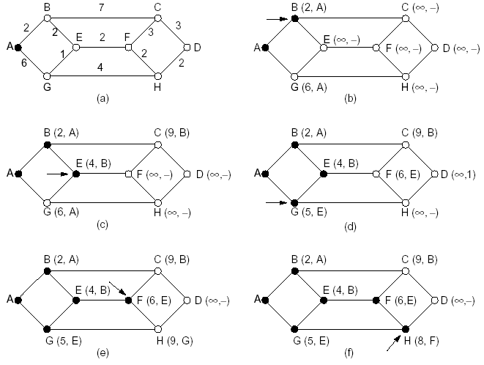
we want to find the path from A to D
the shortest path is ABEFHD

